Slide 1
INDIGO Peer Learning Session
Whose data is it anyway?
17 November 2022
Welcome!

Slide 2
Our agenda
Welcome and housekeeping rules
Impact Bond Dataset and data completeness
Speakers' introduction
Discussion based on three guiding questions: Whose data is it anyway?
Q&A
Closing remarks
The session is being recorded. Please post questions throughout the chat.

Slide 3





Data, data, data
Accessing available data
Contributing data
Roche et al. 2014, Plos Biology

Slide 4
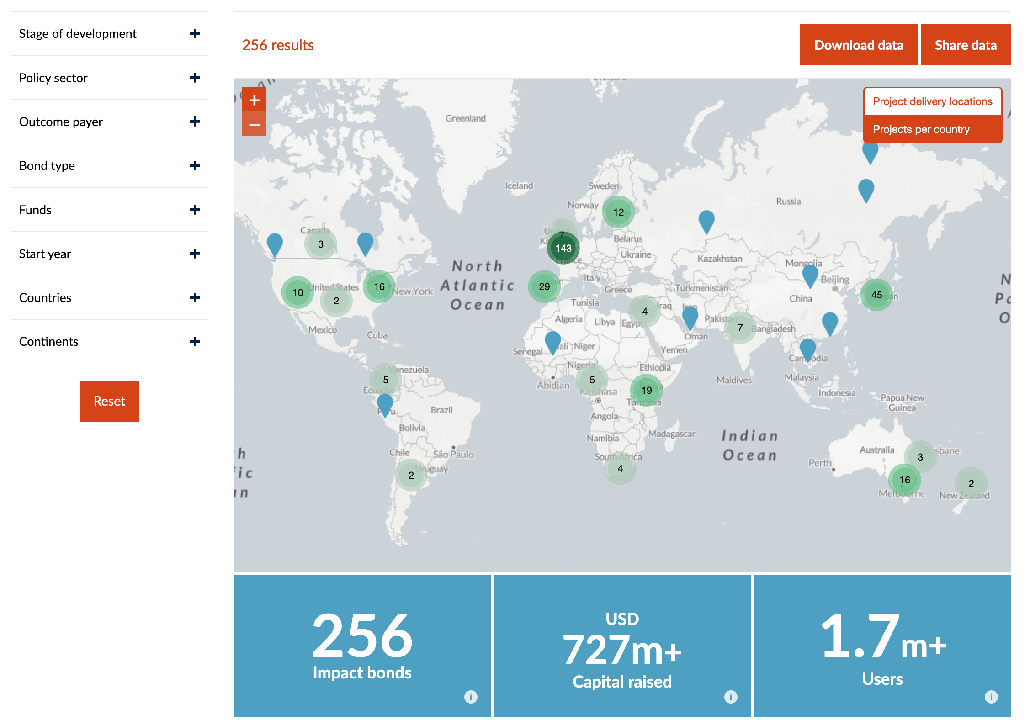
INDIGO updates
Impact Bond Dataset

Slide 5
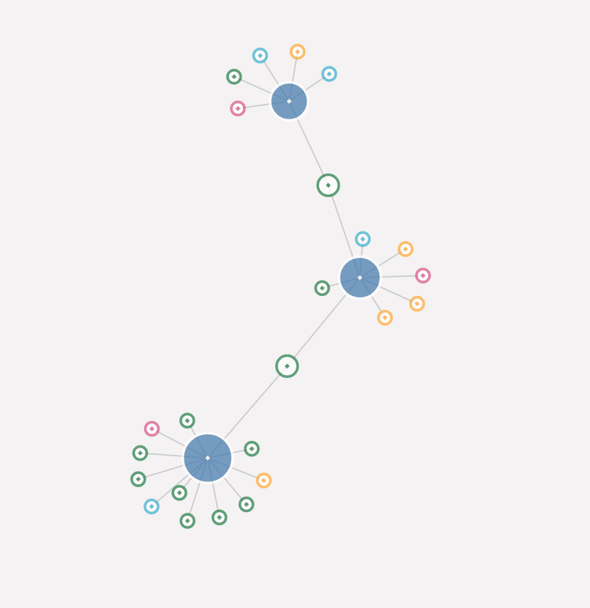
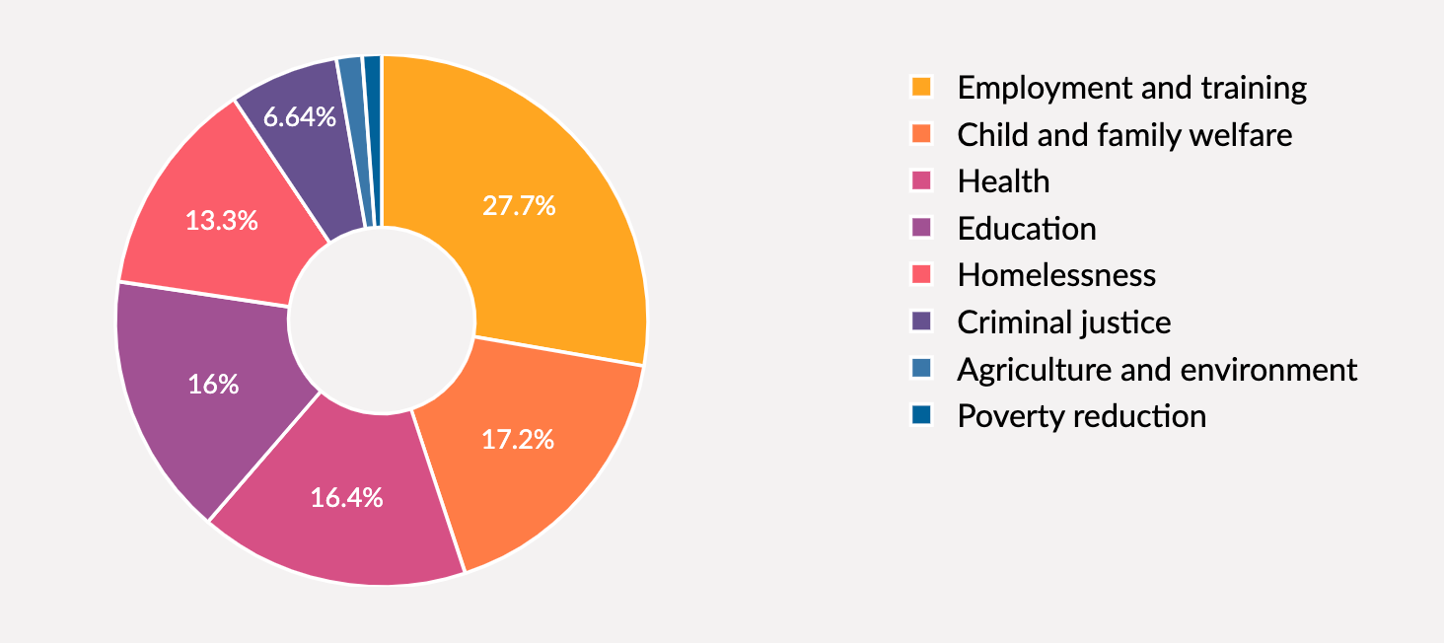
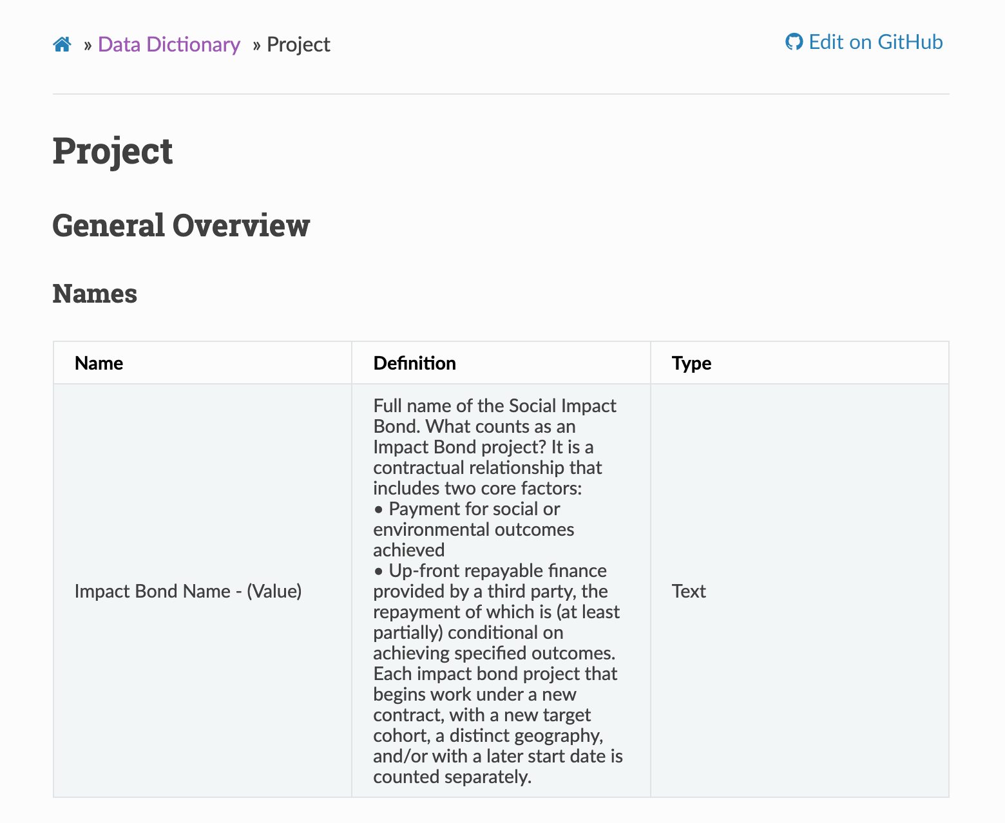

Slide 6

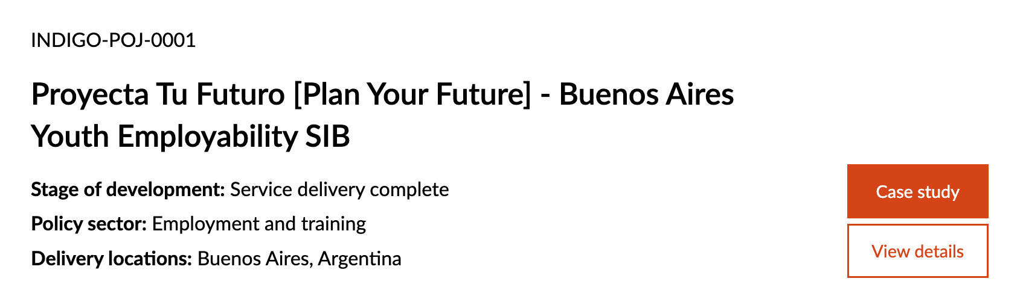

Slide 7
Data completeness report 1
Variable | Percentage
Impact Bond Name - (Value) | 100.0
Alternative Names - (Value) | 14.1
Stage of Development - (Value) | 100.0
Dates - Date outcomes contract signed - (Value) | 68.8
Dates - Anticipated completion date - (Value) | 21.1
Dates - Start date of service provision - (Value) | 92.2
Dates - Anticipated end date of service provision - (Value) | 35.2
Dates - Actual end date of service provision - (Value) | 12.1
Overall project finance - Total investment commitment - Currency - (Value) | 84.4
Overall project finance - Total investment commitment - Amount - Min - (Value) | 5.5
Overall project finance - Total investment commitment - Amount - Exact - (Value) | 78.1
Overall project finance - Total investment commitment - Amount - Max - (Value) | 4.3
Overall project finance - Total investment commitment - Amount USD - Min - (Value) | 5.9
Overall project finance - Total investment commitment - Amount USD - Exact - (Value) | 77.0
Overall project finance - Total investment commitment - Amount USD - Max - (Value) | 4.3
Impact Bond Dataset, 14 November 2022

Slide 8
Data completeness report 2
Variable | Percentage
Overall project finance - Maximum potential outcome payment - Currency - (Value) | 35.9
Overall project finance - Maximum potential outcome payment - Amount - (Value) | 36.3
Overall project finance - Maximum potential outcome payment - Amount USD - (Value) | 21.9
Overall project finance - Maximum potential loss - (Value) | 3.9
Overall project finance - Maximum potential return type - (Value) | 3.5
Overall project finance - Maximum potential return - (Value) | 3.9
Overall project finance - Configuration of the Contracting Parties - (Value) | 13.7
Purpose and classifications - Intervention - (Value) | 96.1
Purpose and classifications - Policy sector - (Value) | 100.0
Service and beneficiaries - Target population - (Value) | 95.7
Service and beneficiaries - Targeted number of unique service users or beneficiaries (total) - (Value) | 74.2
Service and beneficiaries - Actual number of unique service users or beneficiaries engaged (total) - (Value) | 15.6
Changes to project due to COVID-19 - (Value) | 10.5
Impact Bond Dataset, 14 November 2022

Slide 9
Data completeness report 3
Variable | Percentage
Outcome Funds | 43.0
Delivery Locations | 100.0
Service Provisions | 96.9
Outcome Payment Commitments | 99.2
Investments | 95.7
Intermediary services | 85.5
Outcome Metrics | 98.0
Outcome Pricings | 1.6
Results | 21.9
Impact Bond Dataset, 14 November 2022

Slide 10

Our speakers
Daniella Jammes
Freshfields Bruckhaus Deringer LLP

Slide 11




Our speakers
Philip Messere
The National Lottery Community Fund
Pompy Sridhar
MSD for Mothers
Dr. Nevilene Slingers
South African Medical Research Council
Ruairi Macdonald
GO Lab

Slide 12
Our guiding questions
What data points from other projects would you find most helpful? Why are these particularly useful?
If that data is not publicly available, where do you get it from now?
What are the barriers to publishing this data? Can you think of examples (or suggest innovative ideas) to overcome these barriers?

